Slide 1
虛擬化技術 Virtualization Techniques
Network Virtualization
InfiniBand Virtualization

Slide 2
Agenda
Overview
What is InfiniBand
InfiniBand Architecture
InfiniBand Virtualization
Why do we need to virtualize InfiniBand
InfiniBand Virtualization Methods
Case study

Slide 3
Agenda
Overview
What is InfiniBand
InfiniBand Architecture
InfiniBand Virtualization
Why do we need to virtualize InfiniBand
InfiniBand Virtualization Methods
Case study

Slide 4
IBA
The InfiniBand Architecture (IBA) is a new industry-standard architecture for server I/O and inter-server communication.
Developed by InfiniBand Trade Association (IBTA).
It defines a switch-based, point-to-point interconnection network that enables
High-speed
Low-latency
communication between connected devices.

Slide 5
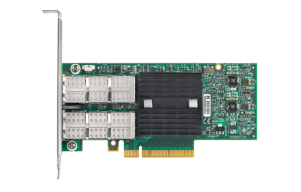
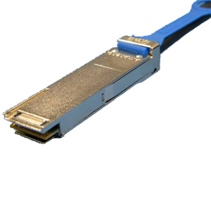

InfiniBand Devices
Adapter Card
Cable
Switch

Slide 6
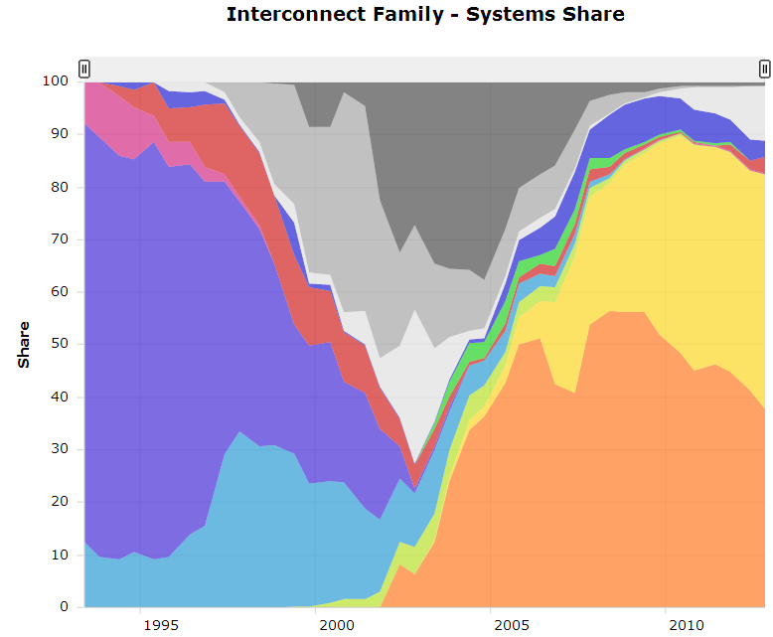
Usage
InfiniBand is commonly used in high performance computing (HPC).
InfiniBand 44.80%
Gigabit Ethernet
37.80%

Slide 7
InfiniBand VS. Ethernet
 | Ethernet | InfiniBand
Commonly used in what kinds of network | Local area network(LAN) or wide area network(WAN) | Interprocess communication (IPC) network
Transmission medium | Copper/optical | Copper/optical
Bandwidth | 1Gb/10Gb | 2.5Gb~120Gb
Latency | High | Low
Popularity | High | Low
Cost | Low | High

Slide 8
Agenda
Overview
What is InfiniBand
InfiniBand Architecture
InfiniBand Virtualization
Why do we need to virtualize InfiniBand
InfiniBand Virtualization Methods
Case study

Slide 9
InfiniBand Architecture
The IBA Subnet
Communication Service
Communication Model
Subnet Management

Slide 10
IBA Subnet Overview
IBA subnet is the smallest complete IBA unit.
Usually used for system area network.
Element of a subnet
Endnodes
Links
Channel Adapters(CAs)
Connect endnodes to links
Switches
Subnet manager

Slide 11
IBA Subnet

Slide 12
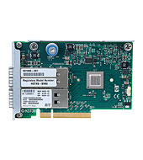
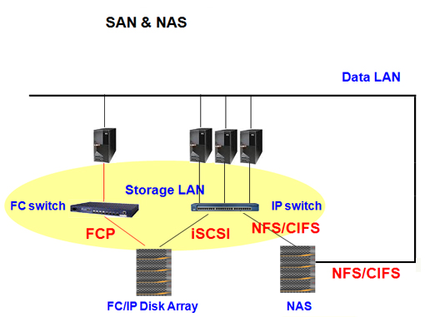
Endnodes
IBA endnodes are the ultimate sources and sinks of communication in IBA.
They may be host systems or devices.
Ex. network adapters, storage subsystems, etc.

Slide 13
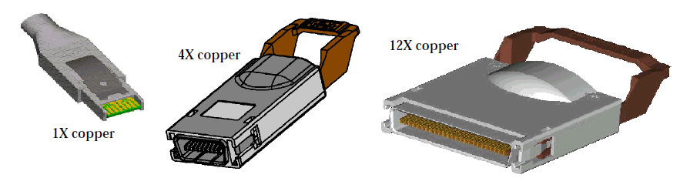
Links
IBA links are bidirectional point-to-point communication channels, and may be either copper and optical fibre.
The base signalling rate on all links is 2.5 Gbaud.
Link widths are 1X, 4X, and 12X.

Slide 14
Channel Adapter
Channel Adapter (CA) is the interface between an endnode and a link
There are two types of channel adapters
Host channel adapter(HCA)
For inter-server communication
Has a collection of features that are defined to be available to host programs, defined by verbs
Target channel adapter(TCA)
For server IO communication
No defined software interface

Slide 15
Switches
IBA switches route messages from their source to their destination based on routing tables
Support multicast and multiple virtual lanes
Switch size denotes the number of ports
The maximum switch size supported is one with 256 ports
The addressing used by switched
Local Identifiers, or LIDs allows 48K endnodes on a single subnet
The 64K LID address space is reserved for multicast addresses
Routing between different subnets is done on the basis of a Global Identifier (GID) that is 128 bits long

Slide 16
Addressing
LIDs
Local Identifiers, 16 bits
Used within a subnet by switch for routing
GUIDs
Global Unique Identifier
64 EUI-64 IEEE-defined identifiers for elements in a subnet
GIDs
Global IDs, 128 bits
Used for routing across subnets

Slide 17
InfiniBand Architecture
The IBA Subnet
Communication Service
Communication Model
Subnet Management

Slide 18
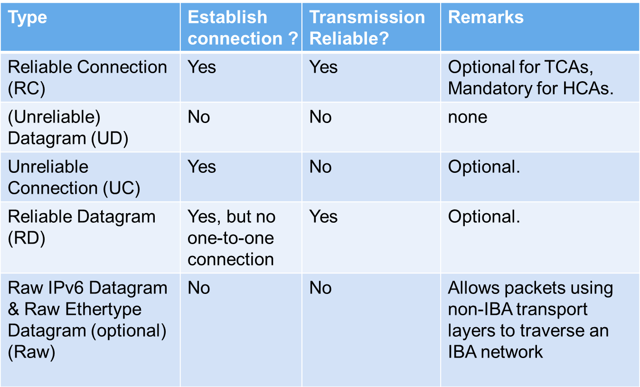
Communication Service Types

Slide 19
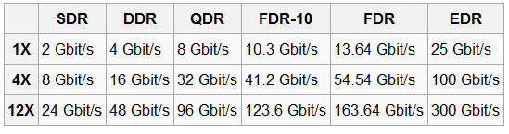
Data Rate
Effective theoretical throughput

Slide 20
InfiniBand Architecture
The IBA Subnet
Communication Service
Communication Model
Subnet Management

Slide 21
Queue-Based Model
Channel adapters communicate using Work Queues of three types:
Queue Pair(QP) consists of
Send queue
Receive queue
Work Queue Request (WQR) contains the communication instruction
It would be submitted to QP.
Completion Queues (CQs) use Completion Queue Entries (CQEs) to report the completion of the communication

Slide 22
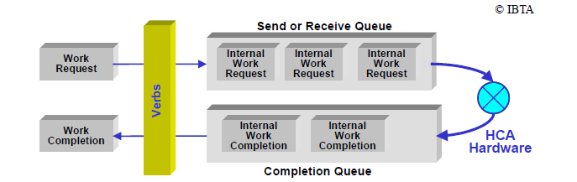
Queue-Based Mode

Slide 23
Access Model for InfiniBand
Privileged Access
OS involved
Resource management and memory management
Open HCA, create queue-pairs, register memory, etc.
Direct Access
Can be done directly in user space (OS-bypass)
Queue-pair access
Post send/receive/RDMA descriptors.
CQ polling

Slide 24
Access Model for InfiniBand
Queue pair access has two phases
Initialization (privileged access)
Map doorbell page (User Access Region)
Allocate and register QP buffers
Create QP
Communication (direct access)
Put WQR in QP buffer.
Write to doorbell page.
Notify channel adapter to work

Slide 25
Access Model for InfiniBand
CQ Polling has two phases
Initialization (privileged access)
Allocate and register CQ buffer
Create CQ
Communication steps (direct access)
Poll on CQ buffer for new completion entry

Slide 26
Memory Model
Control of memory access by and through an HCA is provided by three objects
Memory regions
Provide the basic mapping required to operate with virtual address
Have R_key for remote HCA to access system memory and L_key for local HCA to access local memory.
Memory windows
Specify a contiguous virtual memory segment with byte granularity
Protection domains
Attach QPs to memory regions and windows

Slide 27

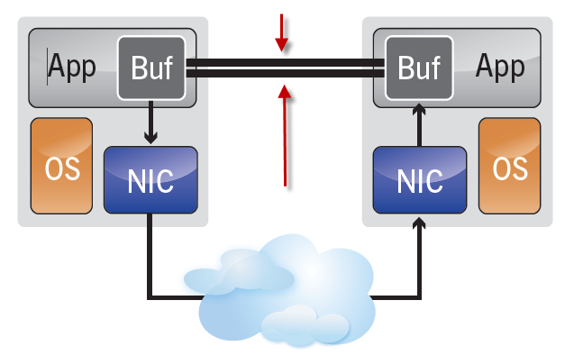
Communication Semantics
Two types of communication semantics
Channel semantics
With traditional send/receive operations.
Memory semantics
With RDMA operations.

Slide 28
Send and Receive
Process
Remote Process
WQE
CQ
CQ
QP
QP
Transport Engine
Transport Engine
Send Recv
Send Recv
Channel
Adapter
Channel
Adapter
Port
Port
Fabric

Slide 29
Send and Receive
Process
Remote Process
WQE
CQ
CQ
QP
QP
Transport Engine
Transport Engine
WQE
Send Recv
Send Recv
Channel
Adapter
Channel
Adapter
Port
Port
Fabric

Slide 30
Send and Receive
Process
Remote Process
CQ
CQ
QP
QP
Transport Engine
Transport Engine
WQE
WQE
Send Recv
Send Recv
Data packet
Channel
Adapter
Channel
Adapter
Port
Port
Fabric

Slide 31
Send and Receive
Complete
Process
Remote Process
CQ
CQ
QP
CQE
QP
CQE
Transport Engine
Transport Engine
Send Recv
Send Recv
Channel
Adapter
Channel
Adapter
Port
Port
Fabric

Slide 32
RDMA Read / Write
Process
Remote Process
Target Buffer
CQ
CQ
QP
QP
Transport Engine
Transport Engine
Send Recv
Send Recv
Channel
Adapter
Channel
Adapter
Port
Port
Fabric

Slide 33
RDMA Read / Write
Process
Remote Process
Target Buffer
WQE
CQ
CQ
QP
QP
Transport Engine
Transport Engine
Send Recv
Send Recv
Channel
Adapter
Channel
Adapter
Port
Port
Fabric

Slide 34
RDMA Read / Write
Process
Remote Process
Target Buffer
Read / Write
CQ
CQ
QP
QP
Transport Engine
Transport Engine
WQE
Send Recv
Send Recv
Data packet
Channel
Adapter
Channel
Adapter
Port
Port
Fabric

Slide 35
RDMA Read / Write
Complete
Process
Remote Process
Target Buffer
CQ
CQ
QP
CQE
QP
Transport Engine
Transport Engine
Send Recv
Send Recv
Channel
Adapter
Channel
Adapter
Port
Port
Fabric

Slide 36
InfiniBand Architecture
The IBA Subnet
Communication Service
Communication Model
Subnet Management

Slide 37
Two Roles
Subnet Managers(SM) : Active entities
In an IBA subnet, there must be a single master SM.
Responsible for discovering and initializing the network, assigning LIDs to all elements, deciding path MTUs, and loading the switch routing tables.
Subnet Management Agents :Passive entities.
Exist on all nodes.
IBA Subnet
Subnet Management Agents
Subnet Management Agents
Master Subnet Manager
Subnet Management Agents
Subnet Management Agents

Slide 38
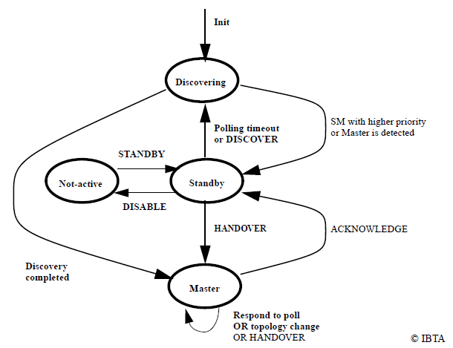
Initialization State Machine

Slide 39
Management Datagrams
All management is performed in-band, using Management Datagrams (MADs).
MADs are unreliable datagrams with 256 bytes of data (minimum MTU).
Subnet Management Packets (SMP) is special MADs for subnet management.
Only packets allowed on virtual lane 15 (VL15).
Always sent and receive on Queue Pair 0 of each port

Slide 40
Agenda
Overview
What is InfiniBand
InfiniBand Architecture
InfiniBand Virtualization
Why do we need to virtualize InfiniBand
InfiniBand Virtualization Methods
Case study

Slide 41
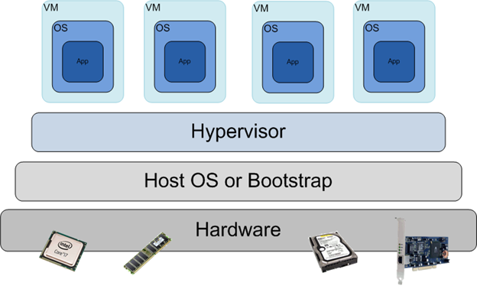
Cloud Computing View
Virtualization is usually used in cloud computing
It would cause overhead and lead to performance degradation

Slide 42
Cloud Computing View
The performance degradation is especially large for IO virtualization.
PTRANS (Communication utilization)
GB/s
PM
KVM

Slide 43

High Performance Computing View
InfiniBand is widely used in the high-performance computing center
Transfer supercomputing centers to data centers
For HPC on cloud
Both of them would need to virtualize the systems
Consider the performance and the availability of the existed InfiniBand devices, it would need to virtualize InfiniBand

Slide 44
Agenda
Overview
What is InfiniBand
InfiniBand Architecture
InfiniBand Virtualization
Why do we need to virtualize InfiniBand
InfiniBand Virtualization Methods
Case study

Slide 45
Three kinds of methods
Fully virtualization: software-based I/O virtualization
Flexibility and ease of migration
May suffer from low I/O bandwidth and high I/O latency
Bypass: hardware-based I/O virtualization
Efficient but lacking of flexibility for migration
Paravirtualization: a hybrid of software-based and hardware-based virtualization.
Try to balance the flexibility and efficiency of virtual I/O.
Ex. Xsigo Systems.

Slide 46
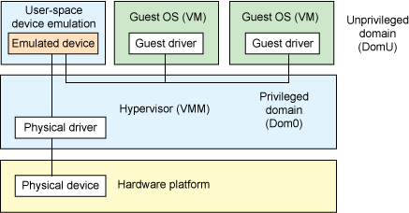
Fully virtualization

Slide 47
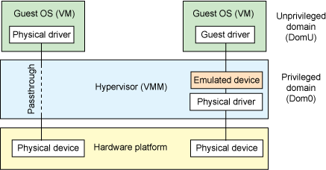
Bypass

Slide 48
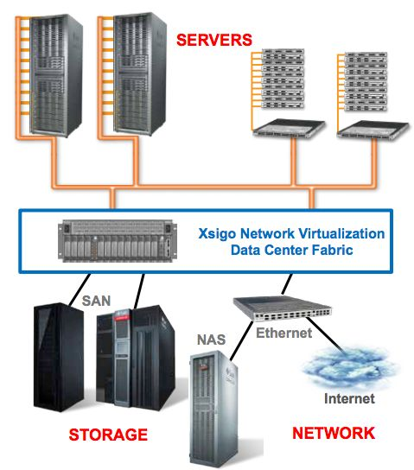
Paravirtualization
Software Defined Network
/InfiniBand

Slide 49
Agenda
Overview
What is InfiniBand
InfiniBand Architecture
InfiniBand Virtualization
Why do we need to virtualize InfiniBand
InfiniBand Virtualization Methods
Case study

Slide 50
Agenda
What is InfiniBand
Overview
InfiniBand Architecture
Why InfiniBand Virtualization
InfiniBand Virtualization Methods
Methods
Case study

Slide 51
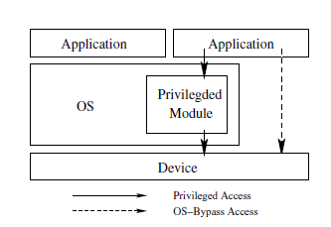
VMM-Bypass I/O Overview
Extend the idea of OS-bypass originated from user-level communication
Allows time critical I/O operations to be carried out directly in guest virtual machines without involving virtual machine monitor and a privileged virtual machine

Slide 52
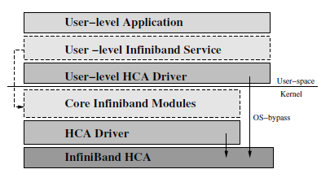
InfiniBand Driver Stack
OpenIB Gen2 Driver Stack
HCA Driver is hardware dependent

Slide 53
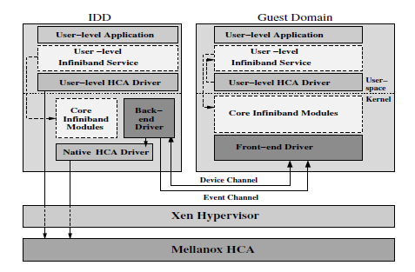
Design Architecture

Slide 54
Implementation
Follows Xen split driver model
Front-end implemented as a new HCA driver module (reusing core module) and it would create two channels
Device channel for processing requests initiated from the guest domain.
Event channel for sending InifiniBand CQ and QP events to the guest domain.
Backend uses kernel threads to process requests from front-ends (reusing IB drivers in dom0).

Slide 55
Implementation
Privileged Access
Memory registration
CQ and QP creation
Other operations
VMM-bypass Access
Communication phase
Event handling

Slide 56
Privileged Access
Memory registration
2
1
Send physical page information
Back-end
driver
Front-end
driver
Memory pinning
Translation
4
3
Register
physical page
Send local and remote key
Native HCA driver
HCA

Slide 57
Privileged Access
CQ and QP creation
1
Guest Domain
Allocate CQ and QP buffer
3
Back-end
driver
Send requests with CQ, QP buffer keys
Front-end
driver
4
Create CQ, QP using those keys
2
Register CQ and QP buffers

Slide 58
Privileged Access
Other operations
1
Back-end
driver
Send requests
Front-end
driver
Keep:
Keep:
IB operation
Resource Pool
(Including QP, CQ, and etc.)
Each resource has itself handle number which as a key to get resource.
3
2
Send back results
Process requests
Native HCA driver

Slide 59
VMM-bypass Access
Communication phase
QP access
Before communication, doorbell page is mapped into address space (needs some support from Xen).
Put WQR in QP buffer.
Ring the doorbell.
CQ polling
Can be done directly.
Because CQ buffer is allocated in guest domain.

Slide 60
Event Handling
Event handling
Each domain has a set of end-points(or ports) which may be bounded to an event source.
When a pair of end-points in two domains are bound together, a “send” operation on one side will cause
An event to be received by the destination domain
In turn, cause an interrupt.

Slide 61
Event Handling
CQ, QP Event handling
Uses a dedicated device channel (Xen event channel + shared memory)
Special event handler registered at back-end for CQs/QPs in guest domains
Forwards events to front-end
Raise a virtual interrupt
Guest domain event handler called through interrupt handler

Slide 62
Case study
VMM-Bypass I/O
Single Root I/O Virtualization

Slide 63
SR-IOV Overview
SR-IOV (Single Root I/O Virtualization) is a specification that is able to allow a PCI Express device appears to be multiple physical PCI Express devices.
Allows an I/O device to be shared by multiple Virtual Machines(VMs).
SR-IOV needs support from BIOS and operating system or hypervisor.

Slide 64
SR-IOV Overview
There are two kinds of functions:
Physical functions (PFs)
Have full configuration resources such as discovery, management and manipulation
Virtual functions (VFs)
Viewed as “light weighted” PCIe function.
Have only the ability to move data in and out of devices.
SR-IOV specification shows that each device can have up to 256 VFs.

Slide 65
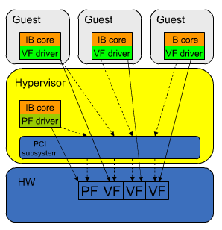
Virtualization Model
Hardware controlled by privileged software through PF.
VF contain minimum replicated resources
Minimum configure space
MMIO for direct communication.
RID for DMA traffic index.

Slide 66
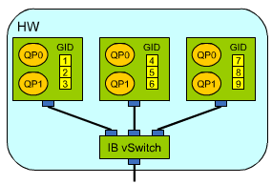
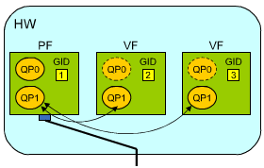
Implementation
Virtual switch
Transfer the received data to the right VF
Shared port
The port on the HCA is shared between PFs and VFs.

Slide 67
Implementation
Virtual Switch
Each VF acts as a complete HCA.
Has unique port (LID, GID Table, and etc).
Owns management QP0 and QP1.
Network sees the VFs behind the virtual switch as the multiple HCA.
Shared port
Single port shared by all VFs.
Each VF uses unique GID.
Network sees a single HCA.

Slide 68
Implementation
Shared port
Multiple unicast GIDs
Generated by PF driver before port is initialized.
Discovered by SM.
Each VF sees only a unique subset assigned to it.
Pkeys, index for operation domain partition, managed by PF
Controls which Pkeys are visible to which VF.
Enforced during QP transitions.

Slide 69
Implementation
Shared port
QP0 owned by PF
VFs have a QP0, but it is a “black hole”.
Implies that only PF can run SM.
QP1 managed by PF
VFs have a QP1, but all Management Datagram traffic is tunneled through the PF.
Shared Queue Pair Number(QPN) space
Traffic multiplexed by QPN as usual.

Slide 70
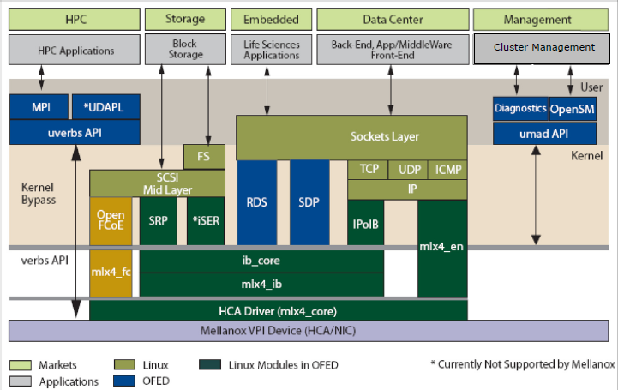
Mellanox Driver Stack

Slide 71
ConnectX2 Support Function
Functions contain ─
Multiple PFs and VFs.
Practically unlimited hardware resources.
QPs, CQs, SRQs, Memory regions, Protection domains
Dynamically assigned to VFs upon request.
Hardware communication channel
For every VF, the PF can
Exchange control information
DMA to/from guest address space
Hypervisor independent
Same code for Linux/KVM/Xen

Slide 72
ConnectX2 Driver Architecture
Same Interface driver─
mlx4_en
mlx4_ib
mlx4_fc
Main Work：
Para-virtualize shared resources
mlx4_core module
PF
mlx4_core module
Hands off Firmware Command and resource allocation of VM
VF
Have
UARs
Protection Domain
Element Queue
MSI-X vectors
Device ID
Device ID
Accepts VF command and executes
Allocates resources
ConnextX2 Device

Slide 73
ConnectX2 Driver Architecture
PF/VF partitioning at mlx4_core module
Same driver for PF/VF, but with different works.
Core driver is identified by Device ID.
VF work
Have its User Access Regions, Protection Domain, Element Queue, and MSI-X vectors
Handle firmware commands and resource allocation to PF
PF work
Allocates resources
Executes VF commands in a secure way
Para-virtualizes shared resources
Interface drivers (mlx4_ib/en/fc) unchanged
Implies IB, RoCEE, vHBA (FCoIB / FCoE) and vNIC (EoIB)

Slide 74
Xen SRIOV SW Stack
Dom0
DomU
tcp/ip
scsi
mid-layer
ib_core
tcp/ip
scsi
mid-layer
ib_core
mlx4_en
mlx4_fc
mlx4_ib
mlx4_en
mlx4_fc
mlx4_ib
mlx4_core
mlx4_core
1
Hypervisor
2
3
4
3
4
guest-physical to machine
address translation
IOMMU
Interrupts and dma from/to device
Communication
channel
Interrupts and dma from/to device
HW commands
Doorbells
Doorbells
ConnectX

Slide 75
KVM SRIOV SW Stack
Linux
Guest Process
User
Kernel
tcp/ip
scsi mid-layer
ib_core
mlx4_en
mlx4_fc
mlx4_ib
mlx4_core
User
Kernel
tcp/ip
scsi mid-layer
ib_core
mlx4_en
mlx4_fc
mlx4_ib
mlx4_core
guest-physical to machine
address translation
2
3
4
1
3
4
IOMMU
Interrupts and dma from/to device
Communication
channel
Interrupts and dma from/to device
HW commands
Doorbells
Doorbells
ConnectX

Slide 76
References
An Introduction to the InﬁniBand™ Architecture
http://gridbus.csse.unimelb.edu.au/~raj/superstorage/chap42.pdf
J. Liu, W. H., B. Abali and D. K. Panda, "High Performance VMM-Bypass I/O in Virtual Machines", in USENIX Annual Technical Conferencepp, 29-42 (June 2006)
Infiniband and RoCEE Virtualization with SR-IOV
http://www.slideshare.net/Cameroon45/infiniband-and-rocee-virtualization-with-sriov

